Slide 1
Red Black Trees
Deletion

Slide 2

Red-black trees that result after successively inserting the keys 41,38,31,12,19,8 into an initially empty red-black tree

Slide 3
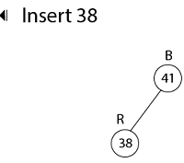
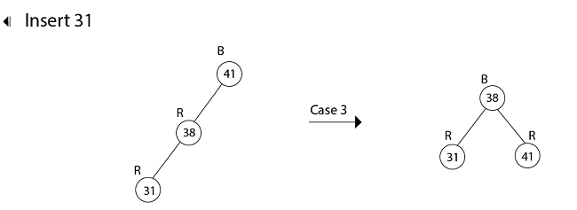

Slide 4
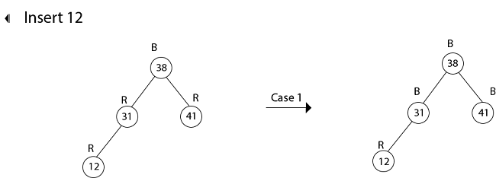
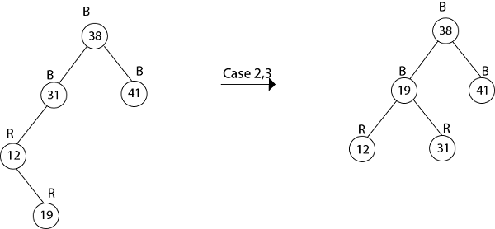
Insert 19

Slide 5
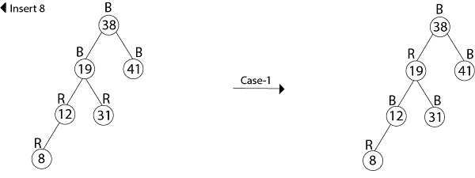

Slide 6
Deletion:
First, search for an element to be deleted
If the element to be deleted is in a node with only left child, swap this node with one containing the largest element in the left subtree. (This node has no right child).
If the element to be deleted is in a node with only right child, swap this node with the one containing the smallest element in the right subtree (This node has no left child).
If the element to be deleted is in a node with both a left child and a right child, then swap in any of the above two ways. While swapping, swap only the keys but not the colors.
The item to be deleted is now having only a left child or only a right child. Replace this node with its sole child. This may violate red constraints or black constraint. Violation of red constraints can be easily fixed.

Slide 7
If the deleted node is black, the black constraint is violated. The elimination of a black node y causes any path that contained y to have one fewer black node.
Two cases arise:
  The replacing node is red, in which case we merely color it black to make up for the loss of one black node.
  The replacing node is black.

Slide 8
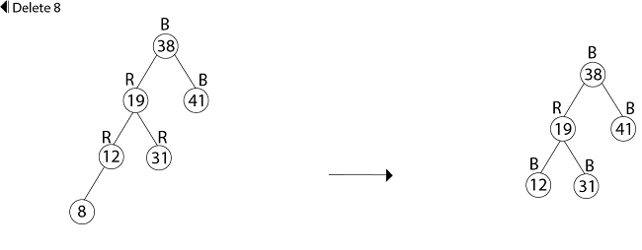
deletion of the keys in the order 8, 12, 19,31,38,41.

Slide 9
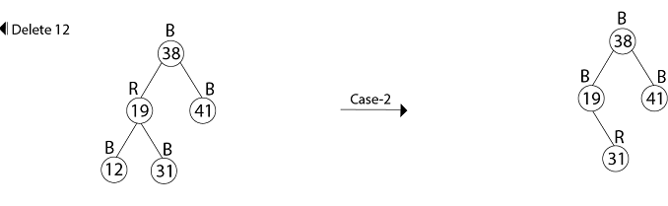

Slide 10
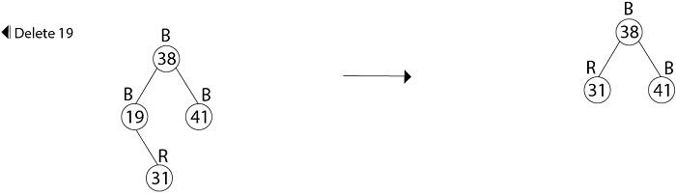

Slide 11
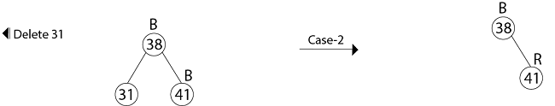

Slide 12
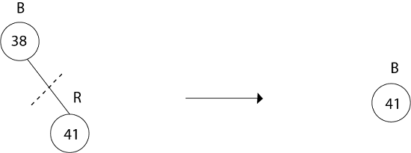
Delete 41
No Tree

Slide 16
Recall the rules for BST deletion
If vertex to be deleted is a leaf, just delete it.
If vertex to be deleted has just one child, replace it with that child
If vertex to be deleted has two children, replace the value of by it’s in-order predecessor’s value then delete the in-order predecessor (a recursive step)

Slide 17
What can go wrong?
If the delete node is red?
Not a problem – no RB properties violated
If the deleted node is black?
If the node is not the root, deleting it will change the black-height along some path

Slide 18
The goal of T-D Deletion
To delete a red leaf
How do we ensure that’s what happens?
  As we traverse the tree looking for the leaf to delete, we change every node we encounter to red.
  If this causes a violation of the RB properties, we fix it

Slide 19
Bottom-Up vs. Top-Down
Bottom-Up is recursive
  BST deletion going down the tree (winding up the recursion)
  Fixing the RB properties coming back up the tree (unwinding the recursion)
Top-Down is iterative
  Restructure the tree on the way down so we don’t have to go back up

Slide 20
Terminology
Matching Weiss text section 12.2
  X is the node being examined
  T is X’s sibling
  P is X’s (and T’s) parent
  R is T’s right child
  L is T’s left child
This discussion assumes X is the left child of P. As usual, there are left-right symmetric cases.

Slide 21
Basic Strategy
As we traverse the tree, we change every node we visit, X, to Red.
When we change X to Red, we know
  P is also Red (we just came from there)
  T is black (since P is Red, it’s children are Black)

Slide 22
Step 1 – Examine the root
If both of the root’s children are Black
  Make the root Red
  Move X to the appropriate child of the root
  Proceed to step 2
Otherwise designate the root as X and proceed to step 2B.

Slide 23
Step 2 – the main case
As we traverse down the tree, we continually encounter this situation until we reach the node to be deleted
X is Black, P is Red, T is Black
We are going to color X Red, then recolor other nodes and possibly do rotation(s) based on the color of X’s and T’s children
2A. X has 2 Black children
2B. X has at least one Red child

Slide 24
Case 2A
X has two Black Children
2A1. T has 2 Black Children
2A2. T’s left child is Red
2A3. T’s right child is Red
** if both of T’s children are Red, we can do either 2A2 or 2A3
P
X
T

Slide 25
Case 2A1
X and T have 2 Black Children
P
P
X
T
X
T
Just recolor X, P and T and move down the tree

Slide 26
Case 2A2
X has 2 Black Children and T’s Left Child is Red
Rotate L around T, then L around P
Recolor X and P then continue down the tree
L
P
T
X
P
T
L
L1
L2
X
L1
L2

Slide 27
Case 2A3
X has 2 Black Children and T’s Right Child is Red
Rotate T around P
Recolor X, P, T and R then continue down the tree
T
P
X
R
T
P
R
R1
R2
X
L
L
R1
R2

Slide 28
Case 2B
X has at least one Red child
Continue down the tree to the next level
If the new X is Red, continue down again
If the new X is Black (T is Red, P is Black)
Rotate T around P
Recolor P and T
Back to main case – step 2

Slide 29
Case 2B Diagram
P
X
T
Move down the tree.
P
P
X
T
T
X
If move to Black child (2B2)
Rotate T around P; Recolor P and T
Back to step 2, the main case
If move to the Red child (2B1) Move down again

Slide 30
Step 3
Eventually, find the node to be deleted – a leaf or a node with one non-null child that is a leaf.
Delete the appropriate node as a Red leaf
Step 4
Color the Root Black

Slide 31
Example 1
Delete 10 from this RB Tree
15
6
17
12
20
3
16
10
13
18
23
7
Step 1 – Root has 2 Black children. Color Root Red
Descend the tree, moving X to 6

Slide 32
Example 1 (cont’d)
15
X
6
17
12
20
3
16
10
13
18
23
7
One of X’s children is Red (case 2B). Descend down the tree, arriving at 12. Since the new X (12) is also Red (2B1), continue down the tree, arriving at 10.

Slide 33
Example 1 (cont’d)
15
6
17
12
20
3
16
10
X
13
18
23
7
Step 3 -Since 10 is the node to be deleted, replace it’s value with the value of it’s only child (7) and delete 7’s red node

Slide 34
Example 1 (cont’d)
15
6
17
12
20
3
16
7
13
18
23
The final tree after 7 has replaced 10 and 7’s red node deleted and (step 4) the root has been colored Black.

Slide 35
Example 2
Delete 10 from this RB Tree
15
6
17
12
20
3
16
2
4
10
13
Step 1 – the root does not have 2 Black children.
Color the root red, Set X = root and proceed to step 2

Slide 36
Example 2 (cont’d)
X
15
6
17
12
20
3
16
2
4
10
13
X has at least one Red child (case 2B). Proceed down the tree, arriving at 6. Since 6 is also Red (case 2B1), continue down the tree, arriving at 12.

Slide 37
Example 2 (cont’d)
15
P
6
17
T
X
12
20
3
16
2
4
10
13
X has 2 Black children. X’s sibling (3) also has 2 black children.
Case 2A1– recolor X, P, and T and continue down the tree, arriving at 10.

Slide 38
Example 2 (cont’d)
15
6
17
P
12
20
3
16
2
4
10
13
X
T
X is now the leaf to be deleted, but it’s Black, so back to step 2.
X has 2 Black children and T has 2 Black children – case 2A1
Recolor X, P and T.
Step 3 -- Now delete 10 as a red leaf.
Step 4 -- Recolor the root black

Slide 39
Example 2 Solution
15
6
17
12
20
3
16
2
4
13

Slide 40
Example 3
Delete 11 from this RB Tree
15
10
5
12
3
7
11
13
Valid and unaffected Right subtree
2
4
6
9
Step 1 – root has 2 Black children. Color Root red.
Set X to appropriate child of root (10)

Slide 41
Example 3 (cont’d)
15
X
10
5
12
3
7
11
13
2
4
6
9
X has one Red child (case 2B)
Traverse down the tree, arriving at 12.

Slide 42
Example 3 (cont’d)
15
P
10
5
T
X
12
3
7
11
13
2
4
6
9
Since we arrived at a black node (case 2B2) assuring T is red and P is black), rotate T around P, recolor T and P
Back to step 2

Slide 43
Example 3 (cont’d)
15
5
P
10
X
3
7
T
12
2
4
6
9
11
13
Now X is Black with Red parent and Black sibling.
X and T both have 2 Black children (case 2A1)
Just recolor X, P and T and continue traversal

Slide 44
Example 3 (cont’d)
15
5
10
P
3
7
12
X
T
2
4
6
9
11
13
Having traversed down the tree, we arrive at 11, the leaf to be deleted, but it’s Black, so back to step 2.
X and T both have two Black children. Recolor X, P and T.
Step 3 -- delete 11 as a red leaf.
Step 4 -- Recolor the root black

Slide 45
Example 3 Solution
15
5
10
3
7
12
2
4
6
9
13

